Slide 1

DataDrop
[Presenter's Name Here]
COMPUTING TEACHER

Slide 2

Learning Objectives
Key concepts in understanding databases and their applications
By the end of this lesson, you will be able to define essential terms related to databases such as database, table, record, field, and primary key. You will also learn to explain why databases are superior to spreadsheets for handling large data sets, and how to navigate Microsoft Access effectively.

Slide 3

Where Does Spotify Store All Its Data?
Data Lives Here
Spotify uses databases to store and manage songs efficiently.

Slide 4



Databases Everywhere
Spotify
TikTok
NHS
100 million songs stored in a database
Billions of videos managed through databases
67 million patient records organized efficiently

Slide 5
Databases vs Spreadsheets
Understanding the differences between data management
Spreadsheets
Databases
Spreadsheets are designed for small data sets and typically allow only one user to access and edit the information at a time. They are ideal for managing simple lists or calculations, enabling users to manipulate data easily. However, as data grows, spreadsheets become less efficient, leading to potential errors and limitations in data organization.
Databases are built for large data volumes and support multiple users accessing the information simultaneously. They excel in fast searching and managing complex relationships between different data sets. Databases ensure data integrity and security while allowing for advanced functionalities like running queries and generating reports, making them ideal for organizations with significant data needs.

Slide 6
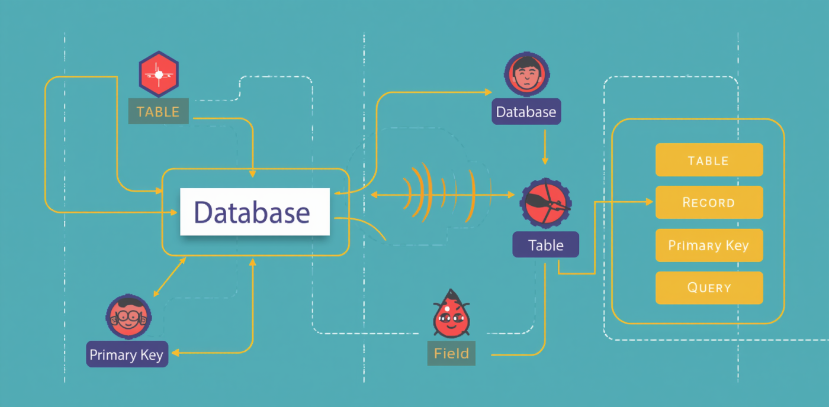
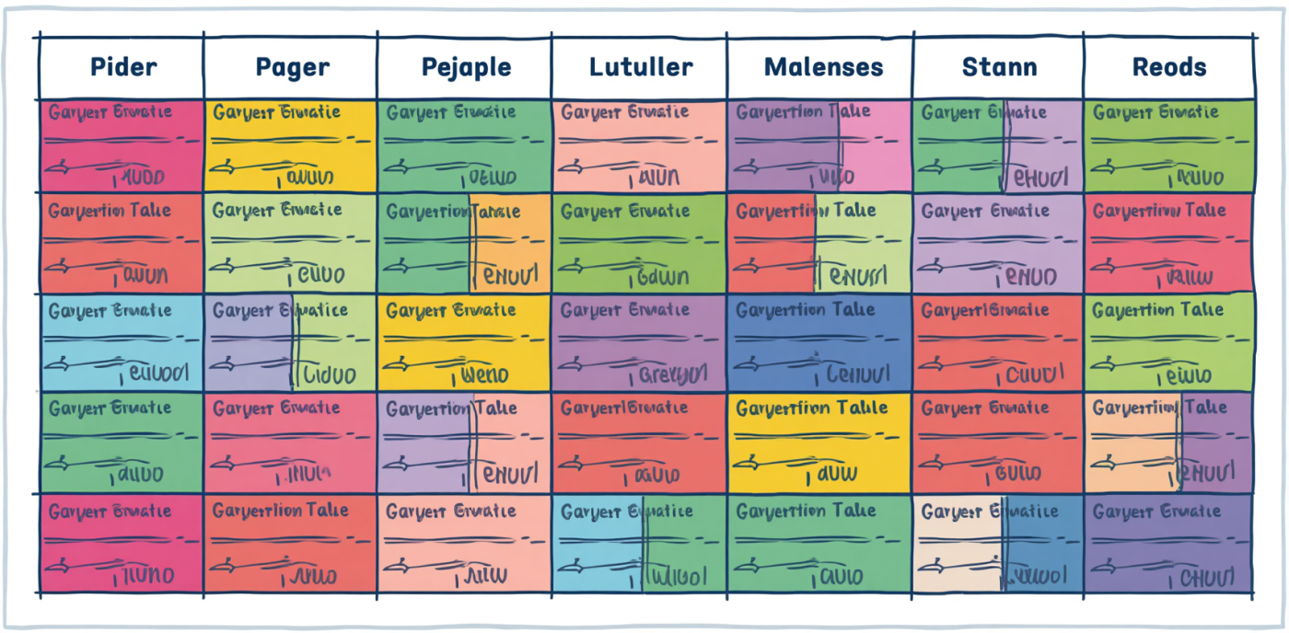




Database
Table
Record
Organised electronic collection of information
Grid of rows and columns for data
All data about one item displayed
Field
Primary Key
Query
One piece of information in a record
Unique identifier for each record
A question asked of the database

Slide 7
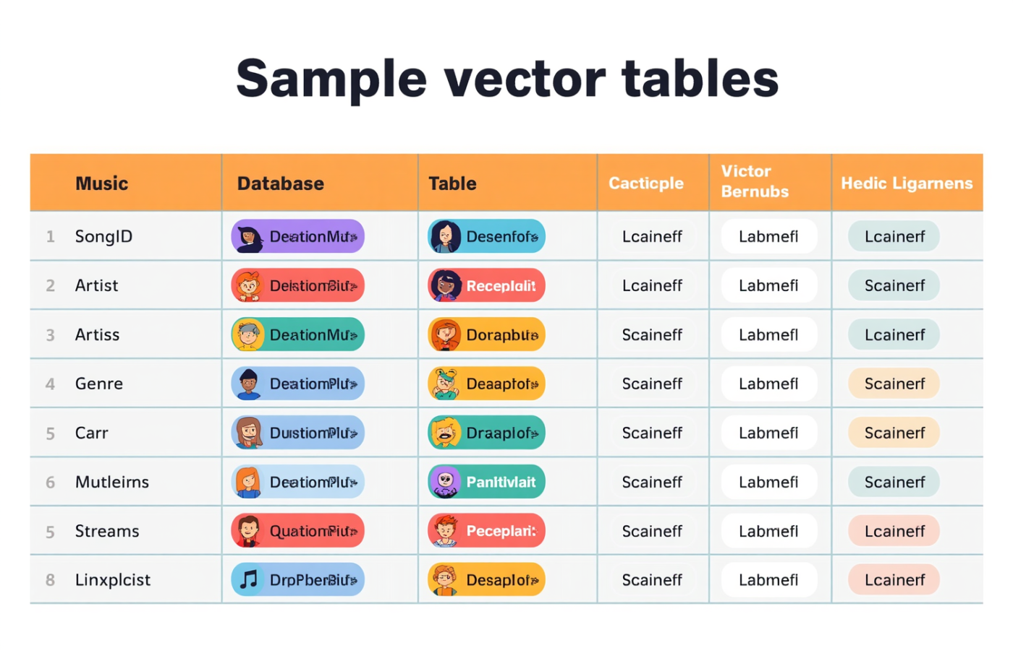
The DataDrop Songs Table Explained
Database Fields
This table shows essential information about each song.

Slide 8
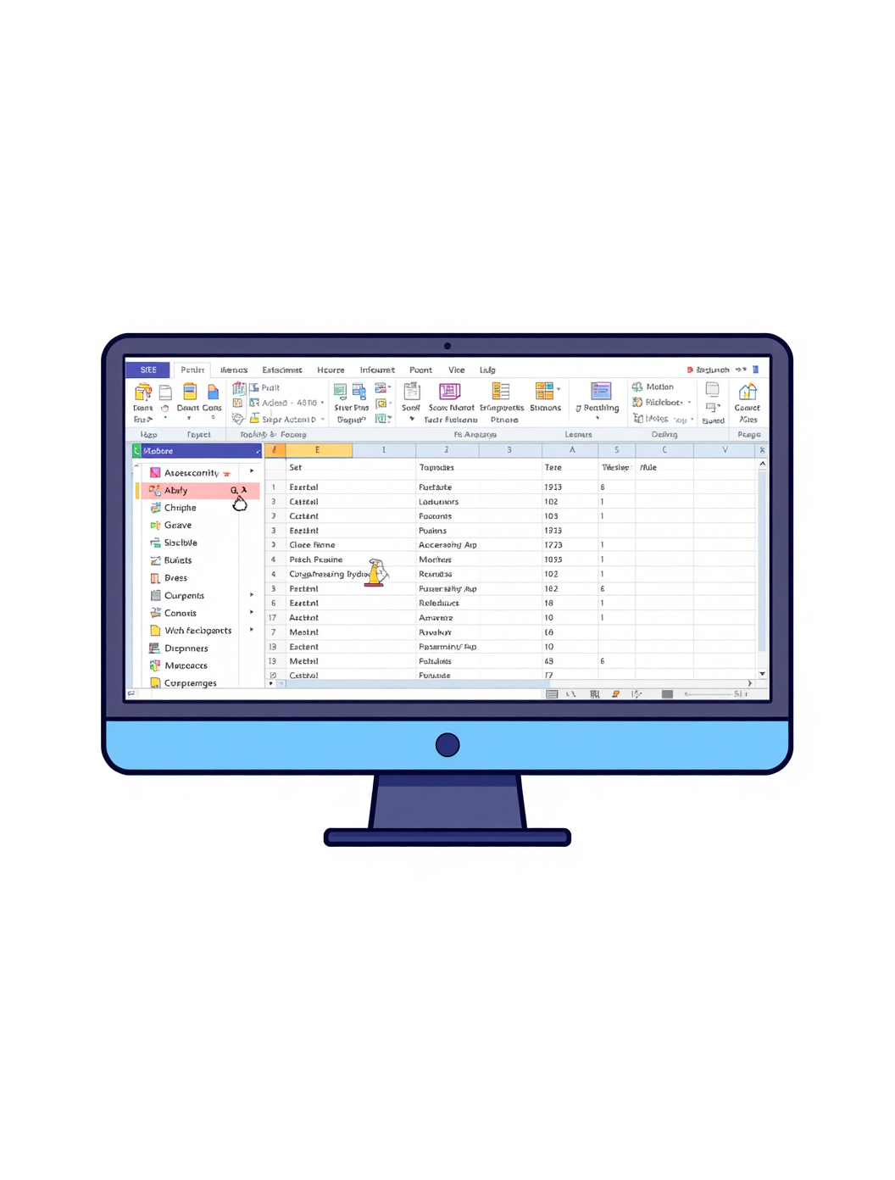
Open the Database
Learn how to navigate and explore the DataDrop database in Access
In this practical session, you will open the DataDrop database and familiarize yourself with its layout. By counting records and identifying fields, you will gain essential skills in handling databases effectively. Understanding these practical aspects will prepare you for more complex database tasks and queries in future lessons.

Slide 9
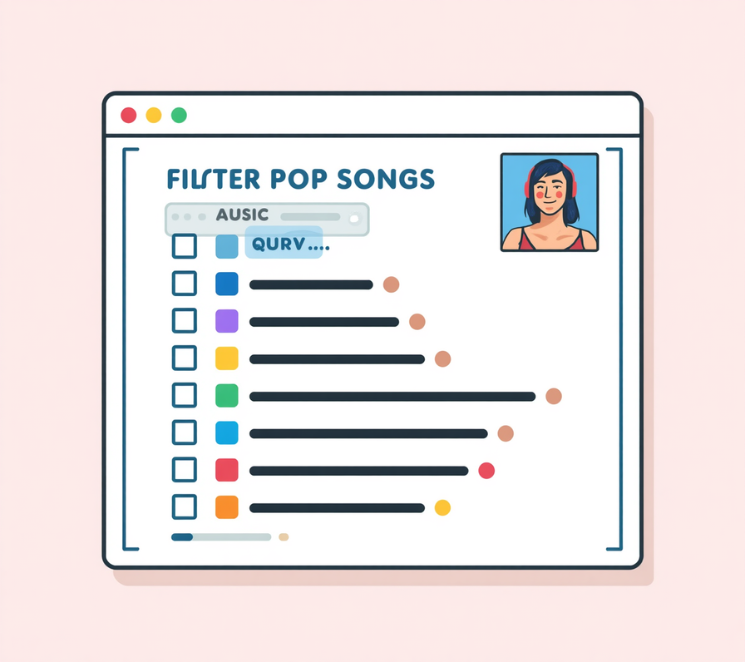
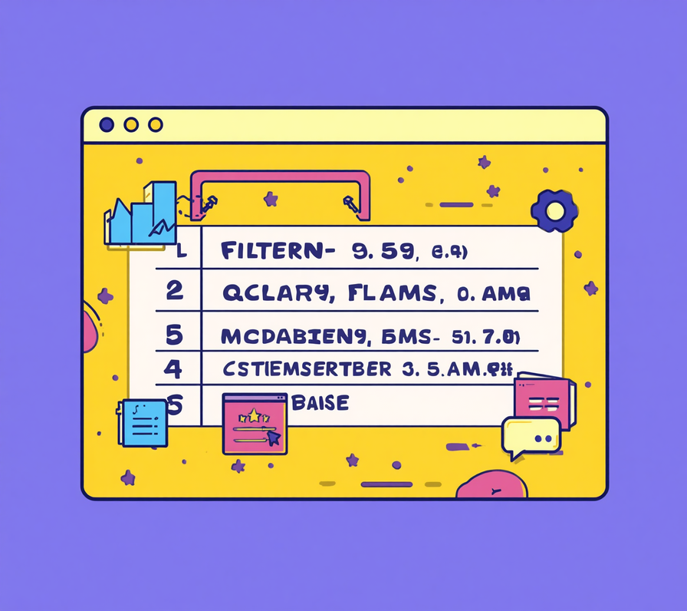

Running Queries
Pop Songs
High Streams
Released 2021
Filter songs by genre: Pop music
Sort songs with over 5 million streams
Display songs released in 2021

Slide 10

Exit Quiz
Test your understanding of databases and key concepts learned today!
It's time to check your knowledge! This exit quiz will help you review important terms such as records, fields, and primary keys. Reflect on what you've learned during this lesson about the importance of databases and how they differ from spreadsheets. Good luck!

