Slide 1

Welcome to DataDrop
Queries in Access
Presented by the DataDrop Team

Slide 2
Learning Objectives
Select Query
Create a select query using the Query Design grid.
Apply Criteria
Use operators to filter data and refine results.
Sort Results
Organize your data by ascending or descending order.
ADDITIONAL NOTES
2

Slide 3
How DataDrop Works
Understanding the query process in Access
Queries and Filtering
A query is essential for filtering data efficiently; it processes user-defined criteria to return specific records from the database, allowing for focused results and easier analysis.
KEY INSIGHTS
3

Slide 4
What is a Query?
A query is a fundamental component of database management, specifically within Microsoft Access. It acts as a question posed to the database, retrieving only the records that meet specified criteria. Here’s how it works:
Filtering: Like a search filter on a shopping site, you set conditions to view relevant results.
Non-destructive: Queries do not alter the underlying data; they provide a filtered view of it.
Versatile: You can create various types of queries to explore data from different perspectives.
For example, if you wanted to find songs in a specific genre during a particular year, a query retrieves only those records, making data exploration efficient and targeted. Understanding queries is vital for effectively managing and analyzing data within Access.
Understanding how queries function in Access
KEY CONCEPTS
4

Slide 5
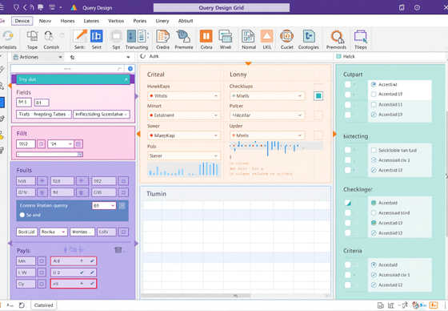
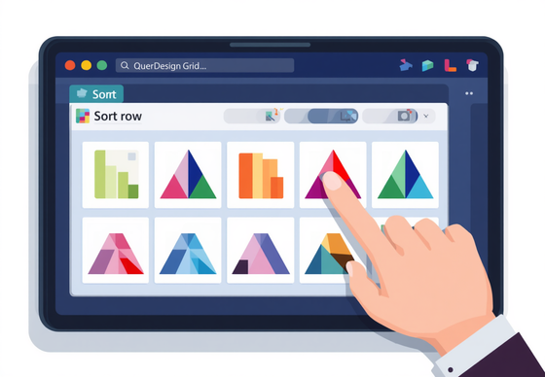
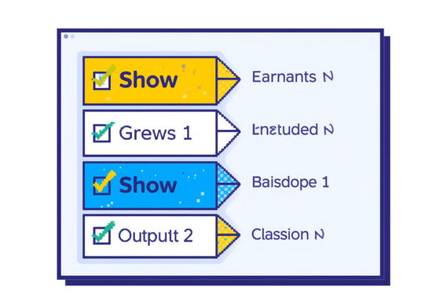
Query Design Grid
Query Field Selection
The Field row allows users to select specific data fields for their queries, customizing results effectively.
Key Components Explained
Sort Options
The Sort row enables users to arrange results, either in ascending or descending order for better data analysis.
Show Checkbox
The Show checkbox determines whether selected fields appear in your query results, helping to filter unnecessary data.
KEY FEATURES
5

Slide 6
Operators Reference
Equal
Greater Than
Less Than
The equal operator (=) is used to compare values for equality, allowing you to filter results that match a specific criterion, such as finding songs labeled "Pop".
The greater than operator (>) filters for values exceeding a specified number, useful for identifying songs with more than a certain number of streams, like over 5 million.
The less than operator (<) helps find values below a set threshold, for example, selecting songs released before the year 2020 based on their release date.
Between
And
Or
The between operator (BETWEEN) allows you to filter results within a specified range, such as identifying songs released between 2019 and 2021 for targeted queries.
The AND operator combines multiple criteria, ensuring that all conditions must be true for a record to appear in the results, like finding songs that are both Pop and over 5 million streams.
The OR operator allows for flexibility by matching records that meet any of the specified conditions, such as filtering for songs that are either Pop or Electronic in genre.
KEY OPERATORS
6

Slide 7
AND vs OR
AND
OR
The AND operator requires that both conditions in a query must be true for the results to be displayed, ensuring a more specific and narrowed-down output.
The OR operator allows for either condition to be true, providing a broader range of results in a query, thereby increasing the chances of finding relevant data.
KEY DIFFERENCES
7

Slide 8
Your 6 Query Tasks
Pop Songs
Streams Filter
Duration Range
Create a query to find all Pop songs available in the database. Ensure to include all relevant fields for comprehensive results and accurate data representation.
Filter songs with more than 5 million streams. Display essential details like Title, Artist, and Streams, and sort results in descending order for better visibility.
Set criteria for songs with a duration between 3 and 4 minutes. This helps narrow down selections to a specific time frame for your listening preferences.
Genre Options
Wildcard Search
Create a query for songs with either Pop or Electronic genres. Limit displayed fields to Title, Artist, and Genre for a focused approach to your results.
Find songs where the title starts with 'The'. Use the LIKE operator with a wildcard to discover all matching entries and enhance your search efficiency.
SUMMARY NOTES
8

Slide 9
Parameterised Queries
A parameterised query is a powerful tool in Microsoft Access that prompts the user for input when run. This feature greatly enhances the flexibility of your queries by allowing you to search for different criteria without needing to create multiple queries.
To create a parameterised query, simply enter a prompt in the criteria row of your desired field. For example, typing [Enter a genre to search:] in the Genre Criteria row will display a dialog box, prompting the user to enter a genre when the query is executed.
This approach not only streamlines your work but also tailors the search experience to the user's needs. Instead of multiple static queries, you can utilize one dynamic query for various inputs, making it a versatile solution for data exploration in your projects.
User input for dynamic searches
ADDITIONAL NOTES
9

Slide 10
Exit Quiz Questions
AND vs OR
The key difference between AND and OR in a query is that AND requires both conditions to be true, while OR allows for either condition to be met.
BETWEEN Criteria
Use the BETWEEN operator to filter results between two values, such as dates or numbers, ensuring only records that fall within the specified range are shown.
Wildcard Usage
In a LIKE query, the wildcard (*) allows for flexible searching by matching any sequence of characters, making it easier to find records that fit general patterns.
QUIZ INSTRUCTIONS
10

Slide 11

Contact Us
Get in Touch with DataDrop
Phone
123-456-7890
Email
hello@reallygreatsite.com
Website
www.reallygreatsite.com

