Slide 1

DATA MANAGEMENT ESSENTIALS
DataDrop — Forms & Reports
Presented by [Your Name]

Slide 2

Learning Objectives for DataDrop Lesson 5
By the end of this lesson, you will be able to explain forms, create and customise them, and generate reports.

Slide 3



The Problem with Datasheet View
Confusing
Deletion
Overwhelming
Datasheet views look like jumbled spreadsheets.
It's easy to delete important data by mistake.
Too many fields can feel overwhelming for users.

Slide 4

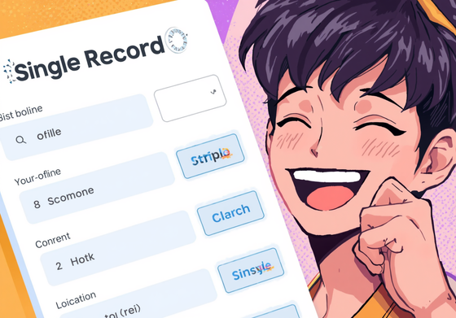

Why Use Forms?
One Record
Reduced Errors
Professional Look
Easily enter data for one record at a time.
Forms minimize the chances of accidental deletions.
Forms create a sleek and branded appearance.

Slide 5
To create a user-friendly form for data entry, start by using the Form Wizard. First, select the Songs table and move all relevant fields across using the >> button. Choose a Columnar layout for better visibility. Once you finish, save your form as 'Songs Entry Form'. Finally, switch to Design View to customize the layout and make adjustments for a polished and professional appearance, ensuring it meets your branding standards.
Creating a Form

Slide 6
Customising your form enhances usability and ensures it aligns with your brand. Start by adding a clear heading such as DataDrop — Add New Song to guide users. Next, change the background color to a dark, on-brand hue, creating a visually appealing interface. Additionally, rename labels for clarity, like changing DurationMins to just Duration (mins). Finally, test your modifications in Form View to ensure everything functions smoothly and looks professional.
Customising Your Form

Slide 7
Reports are essential tools that format database data for printing or presentation. They should always be based on queries rather than raw tables to ensure the data is filtered and sorted first. This process provides a clean and organized output, making it easier to read and understand. For example, creating a report titled "Top Streamed Songs" involves first crafting a query to select the relevant data for a more coherent view.
Reports Overview

Slide 8
To create the Top Songs Report, start by building a query named 'Top Songs Query' from the Songs table. This query should include the fields Title, Artist, Genre, and Streams, sorted in descending order by Streams. Next, launch the Report Wizard, selecting the query you just created. Choose a tabular layout and landscape orientation. After saving your report, switch to Design View to customize the title and header style, and finally check in Print Preview.
Top Songs Report

Slide 9
A parameterised report prompts users for specific input, enhancing data filtering. For instance, by entering a genre, users can generate reports tailored to their preferences. This method not only streamlines the data presentation but also mirrors the functionality of powerful business intelligence tools like Power BI, Tableau, and Google Looker. Such interactive reports allow for a more engaging experience, ensuring that users access relevant information efficiently and effectively.
Parameterised Reports

Slide 10
Exit Quiz: Test Your Knowledge on Forms and Reports
Answer these questions to reinforce your understanding of forms and reports in DataDrop. Good luck!

Slide 11
Get ready for your next mini project!
In this project, you'll build everything from scratch using the skills you've learned in this lesson!

