Slide 1
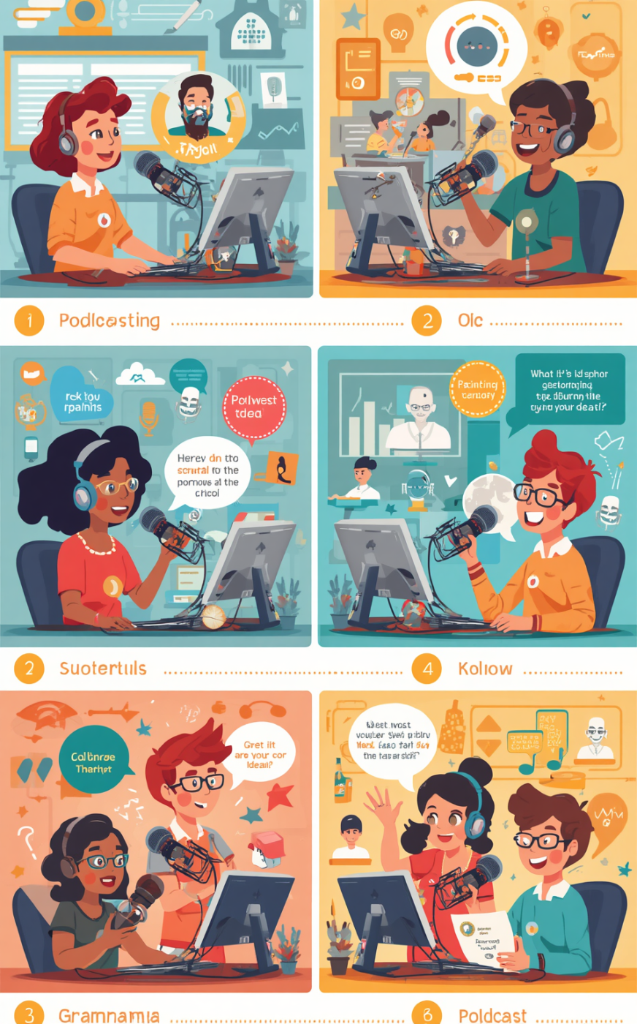

DATADROP
Mini Project: Podcasts
Presented by [Your Name]

Slide 2

The Brief Overview
Lead analyst for Podcasts

Slide 3
What You Must Build
Podcasts Table
You will create a Podcasts table with eight fields to store crucial information about each podcast entry.
Essential components for the Podcasts database project
Primary Key
Ensure the PodcastID is set as the primary key, which uniquely identifies each record in your table.
Validation Rule
Implement at least one validation rule, such as ensuring the number of episodes is always greater than or equal to one.

Slide 4
Table Specification
PodcastID
Title
PodcastID is an AutoNumber field, serving as the primary key to uniquely identify each podcast entry in the database.
The Title field is a Short Text type, allowing for the creative naming of podcasts to attract listeners and convey themes.
Host
Category
The Host field also uses Short Text, capturing the names of the podcast hosts who engage audiences and lead discussions.
The Category field is essential for classifying podcasts into genres, helping users find content like Music, Crime, Comedy, Tech, or Sport.

Slide 5
Table Specification
Episodes Count
AvgListeners Count
The Episodes field must have at least 1 episode, ensuring podcasts are meaningful and engaging for listeners.
AvgListeners tracks the average audience size, helping to assess the podcast’s popularity and reach within its category.
Start Date
Premium Status
The StartDate indicates when the podcast began, providing context for its growth and evolution over time.
The IsPremium field shows if the podcast offers exclusive content, differentiating it from free alternatives and attracting dedicated listeners.

Slide 6
Your SQL Queries
Music Podcasts
To analyze music category podcasts, use a query to select all fields, sorted alphabetically by title for easy navigation.
Explore SQL query creation for podcast data management
Listeners Over 50,000
Create a query that displays the title, host, and average listeners for podcasts exceeding 50,000 listeners, sorted in descending order.
Your Choice
Design a custom query that provides insights for DataDrop, such as showing podcasts starting after a specific date or similar criteria.

Slide 7

Achievement Levels Explained
  01
  02
  03
CAN: Complete the basic project requirements and validate your work.
COULD: Enhance your project with additional features and improved functionality.
SHOULD: Aim for excellence with a polished report and creative SQL queries.

Slide 8
Suggested Timing
Design
Build
SQL Queries
Spend 5 minutes reading the brief and completing the design grid.
Allocate 15 minutes to create the table and enter 10 records.
Dedicate 10 minutes to write and run your 3 SQL queries.

Slide 9
The 2-Minute Pitch
What You Built
You created a Podcasts database with essential fields, ensuring it meets the project specifications set by DataDrop HQ.
Key elements to present your podcast project
Show SQL Query
Demonstrate one SQL query that retrieves all music podcasts, sorted alphabetically by title, showcasing the database's functionality and relevance.
Improvement Ideas
If given more time, consider adding more validation rules and enhancing the user interface for improved data entry and usability.

Slide 10
Peer Review
Swap Databases
Evaluate each other's databases for quality assurance
Exchange your database with a partner to gain fresh perspectives and insights on your work and theirs.
Check Specifications
Ensure your partner’s table aligns with the project specifications, confirming all fields and constraints are correctly implemented.
Provide Feedback
Give two positive comments and one constructive suggestion for improvement to enhance the overall quality of the project.

Slide 11

Any Questions Today?
Thank you for your attention and effort!

